Slide 1
Software Engineering of
Internet Applications
Section 3: Lecture 3
Enterprise Information System Patterns
Dr Laurence Dawson
laurence.dawson@kcl.ac.uk
contact@laurencedawson.com
29 February 2016

Slide 2
Lecture structure
Resuming EIS patterns
  Business tier patterns
  Worked examples
    Composite view
    Session facade
    Composite entity
    Value list handler)

Slide 3
Composite View
This presentation tier pattern has the purpose of managing views which are composed from multiple subviews
Complex web pages are often built out of multiple parts
  Navigation section
  News section
Hard-coding page layout and content provides poor flexibility
The pattern allows views to be flexibly composed as structures of objects

Slide 4
View
*
Basic View
Composite View
Class diagram of composite view

Slide 5
Pattern elements
Elements of the pattern
  View: a general view, either atomic or composite
  View Manager: organises inclusions of parts of views into a composite view
  Composite View: a view that is an aggregate of multiple views.
    Its parts can themselves be composite

Slide 6
Advantages
Modularity
Enhances Flexibility
Enhances Maintainability and Manageability
*http://www.oracle.com/technetwork/java/compositeview-137722.html

Slide 7
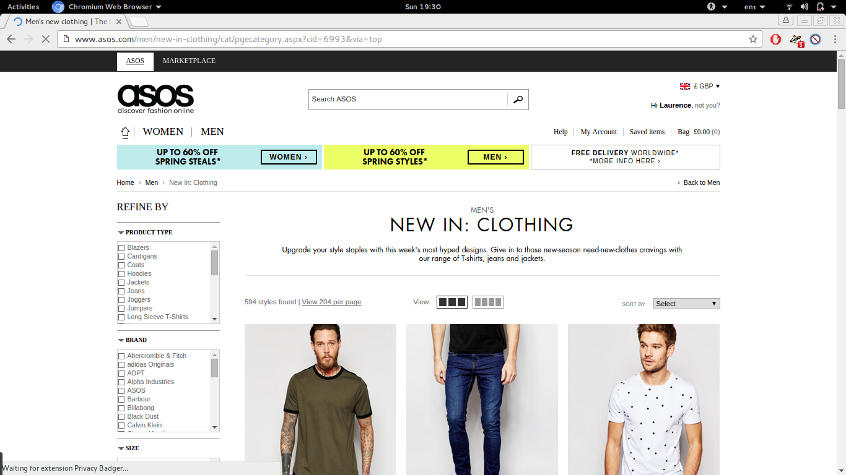
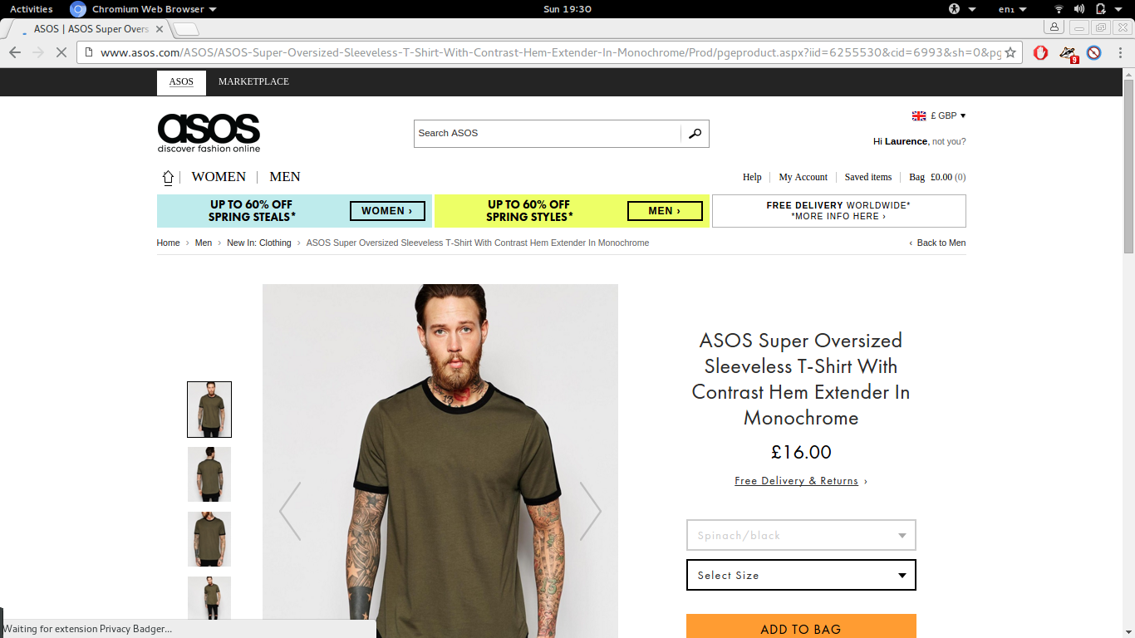

Slide 8
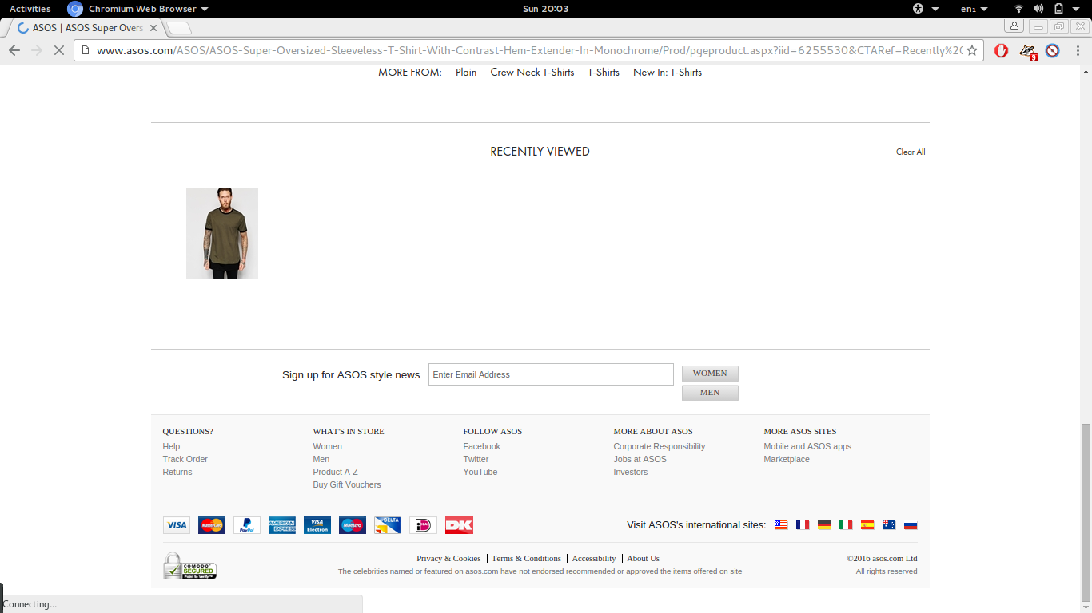

Slide 9
Java Implementation
Implement in JSP
  <jsp:include page = "subview.jsp">
Other approaches include custom JSP tags and XSLT (if data is stored as XML)

Slide 10
Worked example
Implement a composite view to re-use the following elements
  Header
  Footer
  Navigation
Example available at:
  https://github.com/laurencedawson/6CCS3SIA

Slide 11
Value Object
This business tier pattern has the purpose to improve the efficiency of access to persistent data (e.g. in entity beans) by grouping data and transferring data as a group of attribute values of each object
It is inefficient to get attribute values of a bean one-by-one by multiple getatt() calls, since these calls are potentially remote
The pattern reduces data transfer cost by transferring data as packets of values of several attributes. Reduces number of parameters in bean operations
Can transfer data between presentation and business tiers, and between integration and business tiers.

Slide 12
Example
Instead of calling
  getName()
  getAge()
  getAddress()
Return a Value Object containing the variables
Merges three calls into one

Slide 13
Example (cont.)
bean.getName()
bean.getAge()
bean.getAddress()
bean.getValueObject()
public class ValueObject(){
  String name;
  int age;
  String address;
}

Slide 14
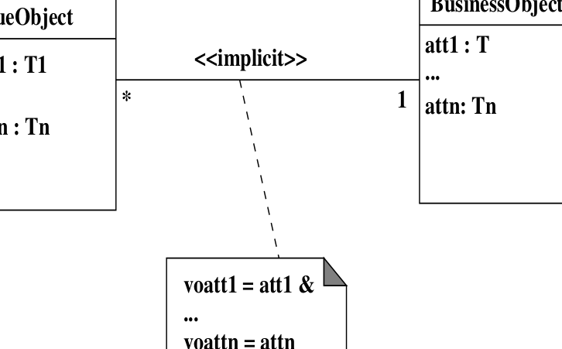
Class diagram of value object

Slide 15
Presentation tier
Controller
View
Bean
Value object
Business tier
DAO
Integration tier
Architecture diagram of value object

Slide 16
Pattern elements
Elements of the pattern are:
  Business Object: can be a session or entity bean. Holds business data. It is responsible for creating and returning the value object to clients on request
  Value Object: holds copy of values of attributes of business object. It has a constructor to initialise these. Its own attributes are normally public

Slide 17
Session Façade
This business tier pattern aims to encapsulate the details of complex interactions between business objects. A session façade for a group of business objects manages these objects and provides a simplified coarse-grain set of operations to clients.
Interaction between a client and multiple business objects may become very complex, with code for many use cases written in the same class
Instead this pattern groups related use cases together in session facades

Slide 18
Architecture of session Façade
Client
Component
Business tier
<<session bean>>
Session Façade
BusinessObject
component 1
BusinessObject
component 2
BusinessObject
component 3

Slide 19
Pattern elements
Elements of the pattern are:
  Client: client of session façade, which needs access to the business service
  SessionFacade: implemented as a session bean. It manages business objects and provides a simple interface for clients
  BusinessObject: can be session beans or entity beans or data

Slide 20
Pattern elements (cont.)
Several related use cases can be dealt with by a single session façade – if these use cases have mainly the same business objects in common
Example: CustomerControllerBean, AccountControllerBean, TxControllerBean

Slide 21
Notes
Need to be careful when writing session façades
  Common functionality should be grouped
  Each façade should not handle too much or run the risk of becoming a “god bean”*
*http://www.jguru.com/faq/view.jsp?EID=1060330

